Slide 1
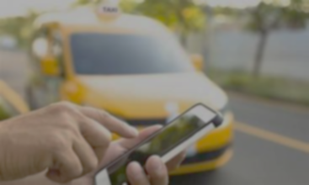
PROJECT PROPOSAL ON ONLINE TAXI BOOKING SYSTEM
SRI LANKA INSTITUTE OF ADVANCED TECHNOLOGICAL EDUCATION (SLIATE)
INDEX NUMBER : - RAT|IT|2022|F|0010
NAME : - M. Pawan Dananjaya Lakshan.

Slide 2
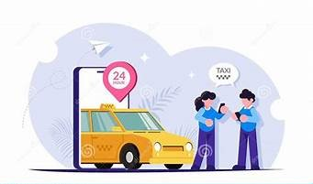
INTRODUCTION
Currently, there is an era where convenience and efficiency are at the top. At the same time, the broadcasting industry has also undergone a profound transformation. With the arrival of smartphones, the necessary facilities have been set up to use the taxi online route that is required for people's travel. But some village not use these apps so i introduce this project for them.

Slide 3
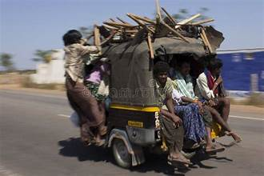
PROBLEM STATEMENT
Sri Lanka is currently known as a developing country. Some cities in Sri Lanka show a very developed character and there are some villages that are still developing. The problem in those villages is that there is no awakening in terms of technology and it is bright. We do not see the use of online taxi system not only in such poor villages but also in some developed cities. It takes a lot of time for those people to find a way to travel. Although it is an urgent matter, the work is delayed due to the time it takes for people to find a shelter. Sometimes they can’t found vehicle .

Slide 4
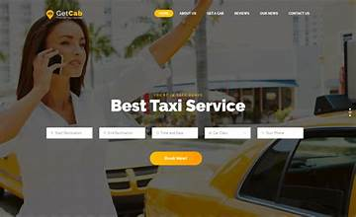
PROPOSED SOLUTION
As a solution for this, we can set up a method to find a nearby taxi by clicking on a link on Google.

Slide 5
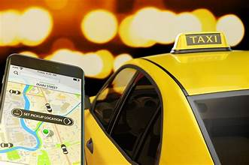
OBJECTIVE
• Entering the places, you want to go.
• Select what vehicle need to travel.
• Receiving the message to the taxi drivers in it’s area.
• If there is someone who wants to go, take over the journey.

Slide 6
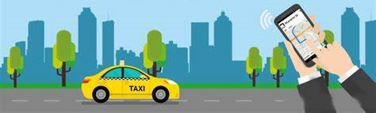
METHODOLOGY
• Finding city villages without a fairly advanced online taxi system.
• Finding out if smartphones are being used in their villages.
• Check if the required signal range is available. [ 2G,3G ]
• Creating the required web page.
• Popularization among people.

Slide 7
BUDGET ANALYSIS
Title | Price ( Rs )
Collection of information to project | 10,000
Website making cost | 35,000
Security and maintain | 45,000
For Ads and leaflet | 30,000
Total | 120,000

Slide 8
TIME FRAME
 | 1st Month |  |  |  | 2nd Month |  |  |  | 3rd Month |  |  |  | 4th Month |  |  |  | 5th Month
Collection of information to project
Making web page
Testing and Bug fixing
Develop web page
Promote web page

Slide 9
THANK YOU!

